Slide 1

Groups ,Teams and Teamwork
Kevin Martin
Notes:
The use of teams in industry, business or educational institutions is not a new practice. Teams are often the vehicle of choice to get things done- to accomplish a task – to complete a school project.
American business has latched on to the “team approach” because of the improved productivity that has been realized by Japanese and European businesses. Team models suggest that increased productivity can result when people are involved on teams and participate in every aspect of a project.
Studies of team performance suggest that up to 85% of them fail to realize their full potential. How can that be when there are thousands of programs that teach about the benefits and concepts of teams and teamwork?
Why is it difficult for a team to realize it’s full potential? Here are just a few reasons.
The lack of a clearly stated – and understood – team goal
The lack of understanding of team process
The right people are not on the team
____________________________________________________________________________________
The real teamwork challenge is the fact that people make up teams. Each individual brings “baggage” with them to the team. Our baggage consists of all the experiences we have had, the expertise we have gained and the behaviors we have learned up to this point in our lives. It is easy to understand why teams fail. People’s baggage can get in the way of positive team performance.
You will be working on a Science Honors Institute project team. Spending time thinking about teams and teamwork can be valuable if you use this experience to understand teaming concepts and your role as a team member. This is your teamwork challenge!

Slide 2
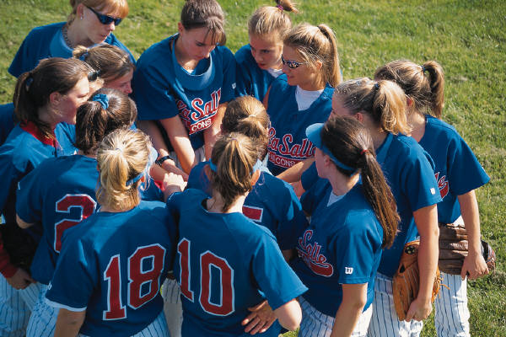
A Group…
…is any number of people who interact with each other, are psychologically aware of one another and perceive themselves to be a group.
Schein (1988)

Slide 3
Natural and created groups
Natural groups are those we are born into and cannot change. These may include race, ethnicity and family.
Created groups are those we choose to join .

Slide 4
Why do people join groups?
Access to information ______________
Shared interests __________________
Social status ____________________
Social contact/friendship ______________

Slide 5
Achieve a goal /complete a task___________
Self esteem/sense of identity__________________
Solidarity/ security_____________

Slide 6
What is a team?
“a small number of people with complementary skills who are committed to a common purpose, performance goals and approach for which they hold themselves mutually accountable”.
Katzenback and Smith
Notes:
Read underlined points p85 manual

Slide 7
Characteristics of teams
Motivated and tightly knit
Specific timescale
Specific tasks
Clear leadership
Small size (2+)
Common goals
Norms
Sanctions

Slide 8
Questions
Size; is it large enough to do the job but small enough for easy communication?
Skills; does the teams have all the necessary skills?
Purpose; is the purpose truly meaningful ?
Goals; are they clear,realistic,specific, shared and measureable

Slide 9
Questions
Working approach; is this clear, shared, fair and well understood?
Mutual accountability; is everyone clear on their individual and joint responsibilities?

Slide 10
Norms
Norms are standards of behaviour which specify the conduct expected of members

Slide 11
A student on this course
_______________________
________________________
________________________

Slide 12
Sanctions-Positive and negative
Rewards are given to those who conform to the norms and punishment to those who deviate from the norms.
Example_________________________________________________________________________________________________________________________________________________________

Slide 13
What are the key benefits of working in a team?

Slide 14

“Synergy is achieved when people work together to create a better solution than either could alone. It’s not your way-- or my way--but a better way.”

Slide 15
Key Benefits of a Team
Better solutions - Collective “Brain Power” often out matches that of a single person.
Increased knowledge – Teams offer new connections that can lead to new ideas.
Notes:
Better solutions – The collective “Brain power” often out matches that of a single person.
Increased knowledge – Teams offer new connections that can lead to new ideas.
As team members listen to the ideas and experience of other team members, a collective intelligence builds up over time. It is from this collective intelligence that the best, most creative, ideas and solutions are conceived.

Slide 16
Why is teamwork important in business?
- increased performance
- increased responsiveness
- increased innovation
- increased motivation
Notes:
Read 4 points above from manual p86

Slide 17

Geese
What do “Geese in Flight” have to do with teams and teamwork?
Notes:
“Geese in Flight” demonstrate some basic team behaviors.

Slide 18


Geese Facts
1. As each goose flaps its wings, an updraft is created for the birds that follow . Flying in the “V” formation increases flying range by 71%.
So what?
People sharing a common goal can reach their goal faster.
Notes:
People sharing a common goal can reach their goal faster.
One of the most common team failures is lack of understanding of a common goal. This may sound simplistic – but it’s a fact.
Team members need to discuss the project assignment in detail to assure that each team member understands the intent and the content. The intent is the purpose of the assignment and the intended learning. The content discussion requires that the team explore each detail of the assignment.

Slide 19
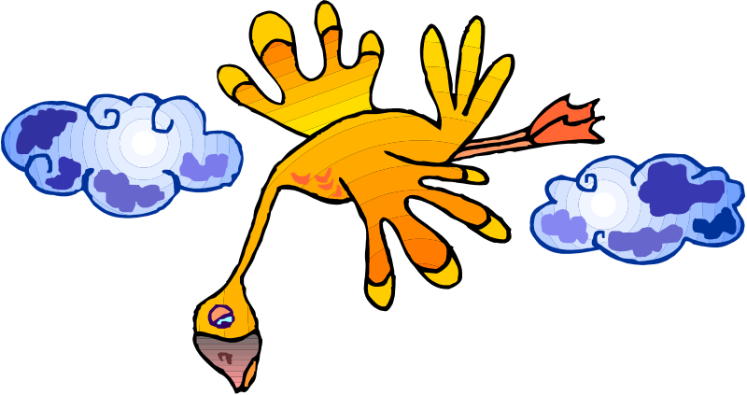

Geese Facts
2. When the lead goose gets tired, it rotates back into the formation – and allows another goose to lead.
So what?
Take turns doing the difficult tasks. Use the talents
of all team members.
Notes:
Take turns doing the difficult tasks. Use the talents of all team members.
Each team member brings different experiences and expertise to the team project. An effective team takes time to learn what each team member feels he or she can contribute.
There may be times when team members feel uncomfortable speaking up. It is the job of other team members to invite him/her into the discussion. When a team doesn’t include all team members in the interaction, it loses the opportunity to capitalize on all the talent available.

Slide 20

Geese Facts
3. The geese in the back honk to encourage those in front.
So what?
Encourage your teammates even when they
make a mistake.
Notes:
Encourage your teammates even when they make a mistake.
It is easy to diffuse the energy of a team with negative comments or by ignoring someone’s contribution. The creative process requires that team members feel comfortable presenting their ideas to the team.
An effective team does not allow any team member to criticize or ignore an idea. Nor does an effective team tolerate criticism when someone makes a mistake.

Slide 21

Geese Facts
4. When a goose gets sick, wounded, or exhausted, two others will follow it to the ground and stay until…
So what?
Share team leadership
Notes:
Share team leadership
Leadership of a team is situational. The most effective teams actively share the leadership role based on the needs of the situation. Leadership can be subtle. It is not always obvious.
Leadership is always about supporting your team members.

Slide 22
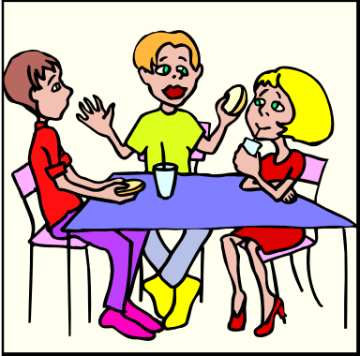
Team Observation Form
Team/Situation | Characteristics or behaviors that made the team effective | Characteristics or behaviors that impeded team effectiveness
1.
2.
3.
What did you observe about teams?

Slide 23


Teams and Teamwork
The Art – What people bring to the team…
Talent …Energy …a Behavioral Style…
The Science – Team Structure and Process
“The How”
Notes:
The Art and the Science of Teams and Teamwork
Let’s spend some time exploring the art and the science of teams. Each team member brings a unique combination of talents and experience to the team. He/she also brings a behavioral style and a personality. Each team member is a a minority of one. The “Art” of teamwork represents the people side of teams. In other words, the “Art” is what each person brings with them to the party. Data and logic are not always the tool to use when working on the people side of teams and teamwork.
The science of teams deals with team structure and process. It is more logical because it provides the tools for the team to work together and create synergy.
You might conclude that the Art of teams is dealing with the “Who” while the science deals with “The How”.

Slide 24


The Art of teamwork
We learn differently
We see differently
We have different Behavioral styles
Notes:
In the book , All I Really Need to Know I Learned in Kindergarten, Robert Fulghum writes “ We are as different from one another on the insides of our heads as we appear to be different on the outside of our heads.”
For example:
We learn differently – some people learn better through sight, while others learn best through auditory stimulation. Still others learn by touching.
2. We see things differently - Everyone has their one set of paradigms (ways they view themselves, others and the world around them).
3. We have different behavioral styles. Our behavioral style is the way we act most frequently. Our behavioral style is the combination of nature (heredity) and nurture (environment).
Understanding the concept of behavioral styles might prove helpful when working on your team project.

Slide 25
Personal Behavioral Style Profile
Style Characteristics
Strong sense of self
Seeks challenges
Logical - Very attentive to details
Wants results
Directive
Sets high standards for self/others
Not into the details
Outspoken
Strong task orientation
Competitive
Works well alone
Wants control of the situation
Handles conflicts indirectly
Analytical
Outgoing - social
Wants clear expectations
Good team player
Develops a process- Gets it done
Readily shares thoughts
Works well in groups/on teams
Enjoys having work recognized
Good Listener
Informal in his/her interfaces
Consistent performer
Supportive
Interactive
Cooperative
Notes:
The history of the 4 factor (quadrant) model of individual behavioral styles is extensive. It includes Hippocrates, who posed a model in 400 B.C. that classified humans into 4 types of temperaments. Galen, another noted Greek physician (200 A.D.), referred to the 4 temperaments of human beings in his writings -- which were translated by the Philosopher Kant in the 18th century. The Kant-Galen-Hippocratic 4 category of temperament types was modified by Wundt in 1903, then Marston in 1928. It goes on and on…
Clearly, since the time of Hippocrates, scientists have analyzed human behavior to discover patterns and relationships. Many instruments have been developed to help identify particular behavioral styles. Although the behavioral styles have different names, each of these instruments basically identify four key behavioral styles. We each have some characteristics of all four styles. We also each have one or two behavioral styles that we most frequently demonstrate.
Slide #10 above provides a brief description of each of the four key behavioral styles. If you read through each of the four quadrants, it is likely that one of these styles is most descriptive of your behavior in most situations.
It is important to note that no style is better than another. In fact, team experts suggest that the most effective teams are those composed of a membership that includes all four behavioral styles.

Slide 26
Personal Behavioral Style Profile
Limitations under Stress/Pressure
Gets very direct with others
Directive
Can be critical of others work
Often critical
Can lack sensitivity
Sticks to procedure and policy
Creates stress and anxiety
Requires clear expectations
Not a “natural” team player
Strong conflict avoidance
Disregards other’s opinions
and decisions
Can over-analyze - “Analysis
paralysis”
Wants control of the situation
Analytical
Impulsive in actions/decisions
Willing to give in
Lacks attention to detail
Wants clear direction before
acting
Supportive
Becomes disorganized
Can perceived change as difficult
Doesn’t manage time well
Sticks to processes/procedures
May back down, or not offer
opinion - wants to be liked
Many different deadlines
can present difficulty
Interactive
Notes:
Behaviorists have taken the study of behavioral styles a step further by describing how persons behave when under stress or feeling pressured. Slide #11 describes the general characteristics of each style when under stress or pressure.
If we become familiar with the various behavioral styles, and how they respond to pressure, it is easier to deal with people in different situations.
Understanding others is the key to good communication, successful and productive work relationships and stellar leadership. Many of us think we know ourselves pretty well, and yet we are still surprised by the way people react at times to the things we say or do. Our challenge is to recognize both our strengths and our limitations -- so that we remain in control of situations -- particularly those situations where we find ourselves typically uncomfortable or ineffective.

Slide 27

What might happen…
Analytical
Directive
The good, the bad and the ugly!
Notes:
What might happen when a person with a directive style , and a person with an analytical style work on a team together?
The good news – The directive person keeps things moving along to get results.
The bad news - The directive person might jump to a solution without allowing for proper analysis or with insufficient data.
The good news – The analytic person will bring logic and data to the discussion.
The bad news – Sometimes analytics over analyze and take too much time to make a decision.

Slide 28
What might happen…
Interactive
Supportive
The good, the bad and the ugly!
Notes:
What might happen when a person with interactive style, and a person with a supportive style work on a team together?
The good news – The interactive person is extremely social and good at building team relationships. This person can also provide creative ideas for the team to consider.
The bad news – The interactive person can jump from subject to subject and lose focus.
The good news – The supportive person can take an idea, break it down and develop a process.
The bad news – When too many ideas are on the table at the same time, the supportive person can get frustrated and shut down.

Slide 29
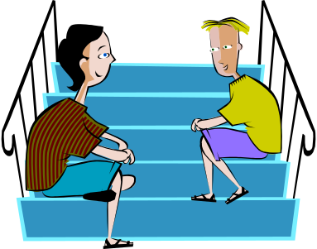
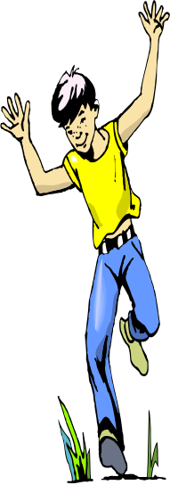
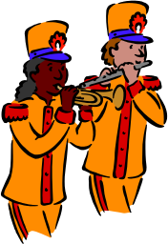
So What? - What’s the message?
Being different from me - is not bad – it’s just different!
Understanding behavioral styles will help you be a more effective communicator and team member
3. You sometimes have to “flex” your behavioral style
Notes:
It is important to recognize, appreciate, and value differences in team members. The truth is, “Different is not bad – it’s just different.”
Understanding behavioral styles will help you be a more effective communicator and team member because you will see people differently.
Because people have different behavioral styles, you sometimes have to “flex” or adjust your behavioral style in order to help the team become more effective.

Slide 30


Four Team Skills
Listening Actively
Using Questions
Setting Groundrules
Sharing information
and ideas
Notes:
There are four team skills worthy of discussion as you prepare to join your project team.
Listening Actively
Using Questions
Setting Groundrules
Sharing information and ideas

Slide 31

Active Listeners
Seek first to understand – then to be understood
Look at the person
Don’t interrupt
Keep emotions in check – “People are entitled own opinions”
Be responsive – relaxed demeanor
Notes:
Most people are selective listeners. They listen only to the part of the conversation that interests them. “Genuine listening is done with your eyes, heart and ears.”
Active listeners seek first to understand – then to be understood. You need to hear what people are saying and what people are not saying. Here are some guidelines for listening actively.
Active listeners
Maintain eye contact – they look at the person who is speaking. This simple action conveys interest, demonstrates respect, increases understanding of the content and the intent of the speaker, and builds trust.
Don’t interrupt – It is frustrating to be interrupted when you are speaking. It is easy to lose a creative thought that might have advanced the team. People shut down when they are consistently interrupted.
Keep emotions in check – People do not all see the world as you do. They each have their own paradigms. When someone states an opinion that is in opposition to what you believe to be true – remind yourself that they have the right to their opinion.
Be responsive - Present a relaxed demeanor. It will demonstrates that you want to hear what the other person has to say.

Slide 32



You have to Practice Active Listening
1. Attending
  Be quiet
  Make eye contact
  Remove physical barriers
2. Following
  Exclamations – “un huh!”,
  Give encouragement – “good point!”
  Ask questions to clarify
3. Reflecting
  Paraphrasing – “Are you saying that…”
  Summarizing – “We seem to be saying…”
Notes:
Most people are not active listeners. This skill should be practiced each day. Active listening has three components.
Attending
Be quiet
Make eye contact
Remove physical barriers
2. Following
Exclamations – “un huh!”, “yes”
Give encouragement – “good point!” – “Tell me more about it.”
Ask questions to clarify
3. Reflecting
Paraphrasing – “Are you saying that…”
Summarizing – “We seem to be saying…”

Slide 33


Questions are used to...
Encourage participation
    “What do you think?”
    “What’s your experience been?”
    “How do you feel about that?”
Clarify ideas
    “Are you saying that …?”
    “Can you help me understand?”
Probe for specifics
    “Can you be more specific?”
    “Can you give some examples?”
    “Where? When? Who? How often?”
Notes:
Questioning skills can be used during team meetings to -
1. Encourage participation
“What do you think?”
“What’s your experience been?”
“How do you feel about that?”
2. Clarify ideas
“Are you saying that …?”
“Can you help me understand?”
3. Probe for specifics – to get more detailed information
“Can you be more specific?”
“Can you give some examples?”
“Where? When? Who? How often?”
If you are a talker, take a break from listening to yourself. Practice using questions to encourage others to share their ideas and perceptions. This will help you to focus away from yourself and onto other team members.

Slide 34

Open-ended Questions
Solicit an opinion, thought or feeling
How? Why? What? Where?
Can you explain/describe...?
Require a more thoughtful response
  “How satisfied are you with...?”
  “Why did you approach it this way?”
  “Where shall we start?”
Notes:
Open ended questions are used to get people to think. Questions that begin with the following words elicit a more thoughtful response from team members.
How? Why? What? Where?
Can you explain/describe...?
“How satisfied are you with...?”
“Why did you approach it this way?”
“Where shall we start?”

Slide 35

Nonverbal Communication
As much as 80% of communication is nonverbal.
SO… what does that mean?
It means that we are communicating all the time

Slide 36

Body Language
If your body says you are bored… people think you are…
Watch what you body says!!!
Align your “nonverbals” with your words
When you see negative body language – Ask questions to learn the real story
Notes:
Since at least 80% of communication is nonverbal, it is important that we are aware of the messages we send with our bodies. If your body language tells me you are bored, I believe you are bored. I will react to that behavior.
Aligning you words with your body language (nonverbals) will increase another person’s ability to understand what you are trying to get across.
When you see someone exhibiting negative body language, don’t make any assumptions. Ask questions to understand the situation.

Slide 37

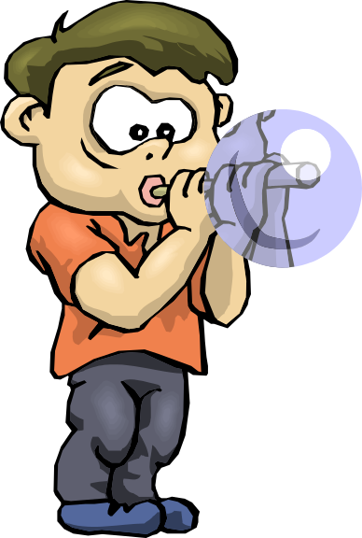
Set Team Groundrules
Behaviors
for success
Everyone participates
All ideas are worth considering
Ask questions
Listen to understand and learn
It’s ok to be different – to have a different perspective
Be mutually supportive of each other
Come prepared
One person speaks at a time
Stay on track
Notes:
Team Groundrules are a set of behaviors, agreed upon by all team members. New teams should take time to identify those groundrules that will help the team work more effectively together.
Slide #25 provides a sample list of Team Groundrules

Slide 38

Sharing Information and Ideas
Share your ideas
Make sure others understand
Invite others to share their ideas
Be positive and enthusiastic
Use questions to check facts
Disagree constructively
Notes:
Ideas are the foundation of a good team discussion. The more ideas the better. Creative thinker build on the ideas of other team member. The team environment must be a safe environment, where all ideas are welcome.
Each person is responsible to share information and ideas. You may need to check to insure people understand what you are saying.
Some team member may not be comfortable with the topic being addressed. They may not share their thoughts unless they are invited.
Ideas should be presented in a positive and enthusiastic way to get the team energy up.
Use questions to check the facts. Don’t get lost because you are afraid to ask for clarification.
Disagree respectfully and constructively. An idea comes from within a person. They own that idea. Your negative comment can be perceived as an attack.

Slide 39
The Science of Teamwork
Process Checks
Decision Making
Team
Meeting
Process

Slide 40
The Science of Teamwork
Team
Meeting
Process
Team member introductions – name, background, behavioral style
Set team “groundrules”
Discuss meeting goals and what should be accomplished
Determine the process/agenda you will use to accomplish meeting goals
Define roles – Discussion leader, note taker, time keeper…
Conduct “Process Check”
Notes:
A meeting is the “vehicle” to accomplish a task. A meeting plan is like the music that members of an orchestra follow. Without a meeting plan, a team will fumble ahead with little direction.
The first time a team meets, it is important to set the stage for dialogue. People need to introduce themselves and tell a little about their background. When people share this information, it is the beginning of trust building among team members.
Team groundrules – “behaviors for success” – should be developed early on. These should be written down and reviewed periodically to see how the team is doing.
Many meetings just start. The assumption is that the assignment has been given, so it must be clear. Often, people have different perceptions of the goal. A few minutes should be devoted to discussing the goal and checking for understanding. A meeting process/agenda should be developed so that all team member know the game plan.
Now, it is time to determine who will assume roles such as discussion leader, time keeper, note taker, etc. These roles should be rotated, as appropriate.
Conduct a process check at the and of the meeting to see where the team needs to improve.

Slide 41

The Science of Teamwork
Decision
Making
Process
Determine how the team will make decisions
-- Consensus
-- Majority
Notes:
At some point, the team will need to discuss how team decisions will be made.
Sometimes, it is important that the group reach consensus. For consensus decision making to be successful, all options are must be identified, discussed and understood. A set of criteria can be developed against which each option can be screened. Those options that do not meet the criteria fall off the list. Groups consensus is reached when all team members agree that they can support a specific option.
Majority rule is a viable decision making process. It is often used when a decision can not be made through consensus.

Slide 42
The Science of Teamwork
Conduct
Process
Check
1. Was the goal clearly stated and understood ?
2. Did everyone participate?
3. Did people dominate the discussion - or interrupt?
4. Did team members listen to and recognize your ideas?
5. Was the process the team followed well organized?
6. Did team stick to the schedule – complete tasks on time?
7. How did the team come to agreement – make decisions?”
8. How could your team have worked more effectively/efficiently?
9. What would you do differently to make the team work better?
Notes:
Teams need to assess their performance. A process check can be used periodically to assess how the team is doing.
To conduct a process check, take a few minute at the end of a team meeting to ask the team to respond to the following questions.
1. Was the goal clearly stated and understood ?
2. Did everyone participate?
3. Did people dominate the discussion - or interrupt?
4. Did team members listen to and recognize your ideas?
5. Was the process the team followed well organized?
6. Did team stick to the schedule – complete tasks on time?
7. How did the team come to agreement – make decisions?”
8. How could your team have worked more effectively/efficiently?
9. What would you do differently to make the team work better?

Slide 43

Teams must be nurtured!
What are one or two things you need to work on to develop yourself in the area of teamwork?
Notes:
We all participate on various teams. Each team experience is an opportunity to become more effective as a team leader and team member. Effective team skills are an indicator for success in the future.
It is not easy to change behavior. First, you have to identify the behaviors you want to change. Next, you have to identify the behavior you want to nurture. Finally, you have to practice the new behavior consistently.
Think carefully -- What are one or two things you need to work on to develop yourself in the area of teamwork?
Use your project team experience to practice these new behaviors until you own them.
Mark Twain once said, “If you always do what you’ve always done, you’ll always get what you’ve always got.”

Slide 44

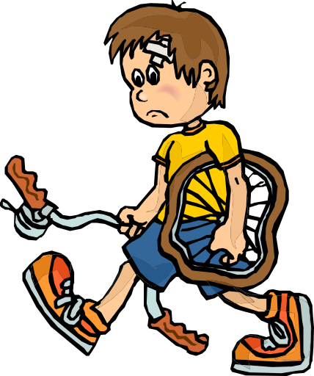
“If you think you can, or you think you can’t, you’re right”
- Henry Ford
Notes:
Organizations will continue to use teams to accomplish work. It is certainly to your advantage to continually improve your teamwork skills. You need to further develop your strengths. You also need to define those behaviors that don’t work for you - then, identify, and practice more effective behaviors.
Your challenge is right in front of you – “You can!”

Slide 45
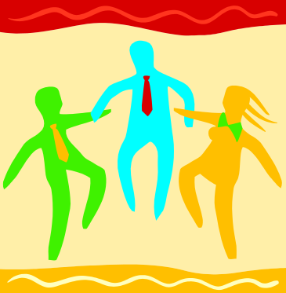
Group effectiveness
GROUP SIZE
GROUP COMPOSITION
TASK
RESOURCES
EXTERNAL RECOGNITION

Slide 46
Group effectiveness
GROUP SIZE
GROUP COMPOSITION
TASK
RESOURCES
EXTERNAL RECOGNITION

Slide 47

Size
Depends on task
Diversity of skills
Limited time to contribute
5-7 optimum
Social loafing

Slide 48

Composition
Homogeneous
Heterogeneous

Slide 49
Homogeneous
Similar demographics
Similar beliefs and values
Less conflict
Less creative
Pressure to conform

Slide 50
Heterogeneous
Greater conflict
Greater creativity/ innovation
Wide range of views/opinions

Slide 51
Nature of task
Realistic task= better performance
Clear task=quicker performance
Not all tasks can be easily defined

Slide 52
Resources/support
Effective resources needed to function properly

Slide 53
External recognition
Being valued by society can be a motivator

Slide 54
STAGES OF GROUP FORMATION (Tuckman 1965)
Teams go through different stages of development
FORMING
STORMING
NORMING
PERFORMING

Slide 55
Tuckman’s Theory of Team Development
adjourning
performing
performance
norming
storming
forming
time
RE: P237-238 UBIL
Notes:
Read manual p88/89

Slide 56
Forming
Uncertain of structure
Collection of individuals
Uncertain of goals
Lack of strategy
Dependent on the leader
Stage of impression management

Slide 57
Storming
Conflict and disagreement
Tendency to rebel
Personal agendas exposed
Testing each other

Slide 58
Norming
Establishing norms and patterns of behavior
Deciding how decisions are to be taken
Cohesive
Sense of group identity and camaraderie
Norms established

Slide 59
performing
Conflicts resolved
Active output

Slide 60
Adjourning
Group preparing for its disbandment
Focus on wrapping up proceedings rather than task performance

Slide 61
Mature groups
Positive regard for members and their opinions
Prepared to compromise
Willingness to adapt to a point of disagreement

Slide 62
None Of Us Is As Smart As All Of Us

Slide 63
Problems in groups
Groupthink and group shift
Social loafing
Conflict
Group anxiety

Slide 64
Groupthink
…..a mode of thinking that people engage in when they are deeply involved in a group and their striving for unanimity override their motivation to realistically appraise alternative courses of action.

Slide 65
Groupthink
Members of a group will not wish to risk any danger to group cohesion by expressing deviant opinions.
Membership is blind.
Isolation from outsiders.
Leader is too dominant.
Groupthink is over cohesiveness

Slide 66
Groupthink
Irving Janis (1972)
Factors causing groupthink phenomenon
Feeling of invulnerability
False logic
Feeling that the group is morally right
Shared stereotypes
Self censorship
Illusion of agreement

Slide 67

Groupthink
Bay of pigs
Challenger space disaster
Waco
Solomon Asch (1956)

Slide 68
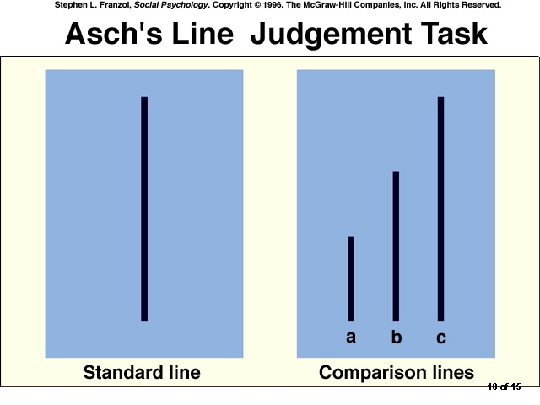

Slide 69
Dealing with groupthink
Individual critical evaluation
Express doubts
Create sub groups
Invite outside experts to comment on groups

Slide 70
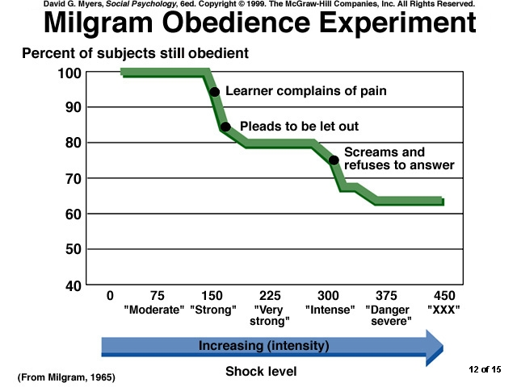

Slide 71
group shift
Type of groupthink
Significant shift in the position of members towards more extreme position in the direction they were already leaning
Conservative groups become more cautious
Risk taking groups take greater risks
Risky shift

Slide 72
social loafing (Ringelman)
Ringelman noted that as you add more people to a group pulling on a rope the total force exerted by the group rose but the average force exerted by each member decreased.

Slide 73
What causes social loafing?
Belief that others are not carrying their fair share
Dispersion of responsibility

Slide 74
Effective group communication
Acceptance of other members and their ideas
Offering support to group members for their contribution
Turn taking
Creating a relaxed atmosphere
Showing agreement
Inviting views and opinions of others
Suggesting actions

Slide 75
Negative group communication
Not contributing
Insulting/ aggressive behavior
Negativity
Self centered communication
Communication apprehension

Slide 76









Notes:
Thank you for sharing your Saturday morning with us.
Enjoy the process.

